Slide 1
Dibromo-pyrene on Cu(111)
2023-08-31

Slide 2
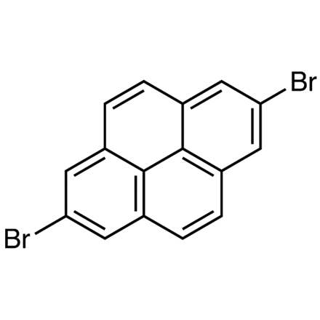
Properties
Molecule: Dibromo-pyrene (DBP)
Structure
Surface: Cu(111)
Amplitude: ~50pm
Height Range: z=70pm – 235pm in steps of 15 pm

Slide 3
1
2
3
4
70pm
85pm
100pm
115pm
5
6
7
8
130pm
145pm
160pm
175pm
9
10
11
12
190pm
205pm
220pm
235pm

